Slide 1

CODEX Marketing Insights

Slide 2
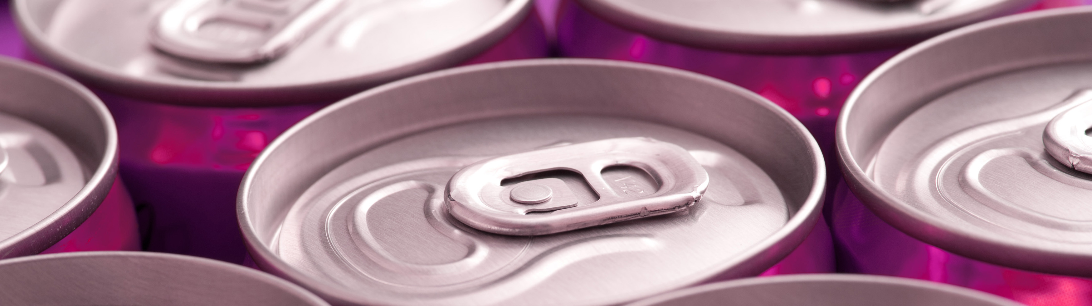
About The Project
CodeX is a German beverage company which is recently launched in India. They launched their energy drink in 10 cities in India.
CodeX conducted a survey in those 10 cities and received results from 10k respondents. The survey was based on consumer behaviour questions like their purchasing habits, their feedback about energy drinks available in the market, pricing, packaging etc. The survey question file is attached at the end of this article

Slide 3
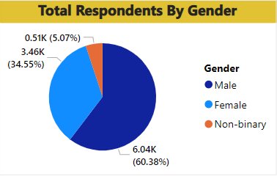
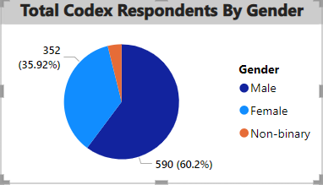
Demographic Insights Preference by Gender
Out of 10 thousand respondents, the number of male respondents is 6038.
This shows 60% of the consumers are male who prefer energy drinks more.
Out of 10 thousand respondents , 980 were codex energy Drink Respondents and out of that 60% were Male.

Slide 4
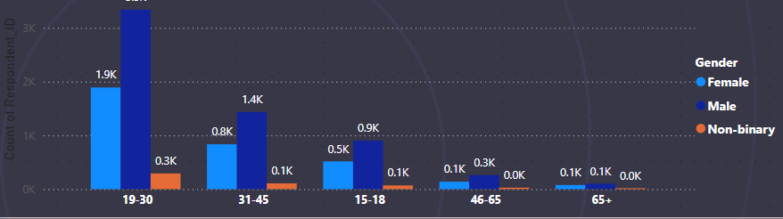
Age Group Preference
From the result of this survey, we get to know that energy drinks are more popular among youngsters. More than 50% of the respondents belong to the Age Group 19-30.
If we look at overall young age groups from 15 to 30, then the % will rise to 70%

Slide 5
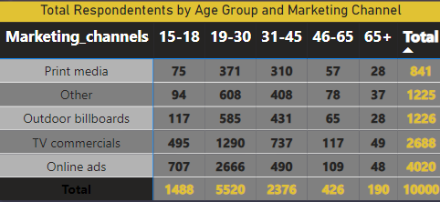
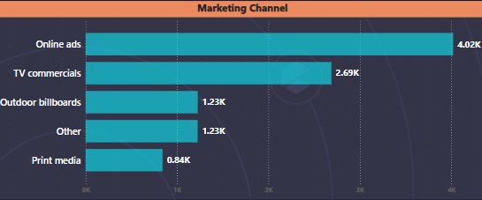
Marketing Channel Reaches Youth(15-30)
Online Ads are the most effective channel that reached 3373 respondents Age group 15-30.
After online Ads ,TV Commercials has better reach to youth and overall as well
So company should market the product on online platforms , use social media marketing such as Influencer marketing

Slide 6
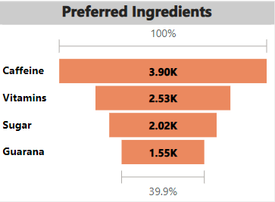
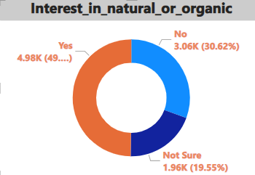
Consumer Preference Over preferred ingredients of energy drinks
As we know caffeine increases attention and alertness, and it is often used in energy drinks. Caffeine is the most expected ingredient followed by the Vitamins in energy drinks
We can see that people expect around 49% expect or require natural or organic ingredients more

Slide 7
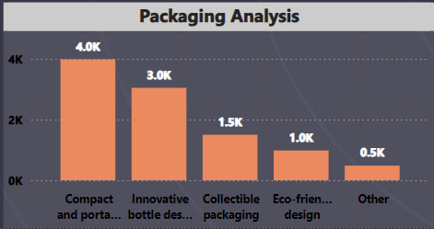
Packing Preference
Compact & Portable Cans are high in demand followed by Innovative Bottle Designs.

Slide 8
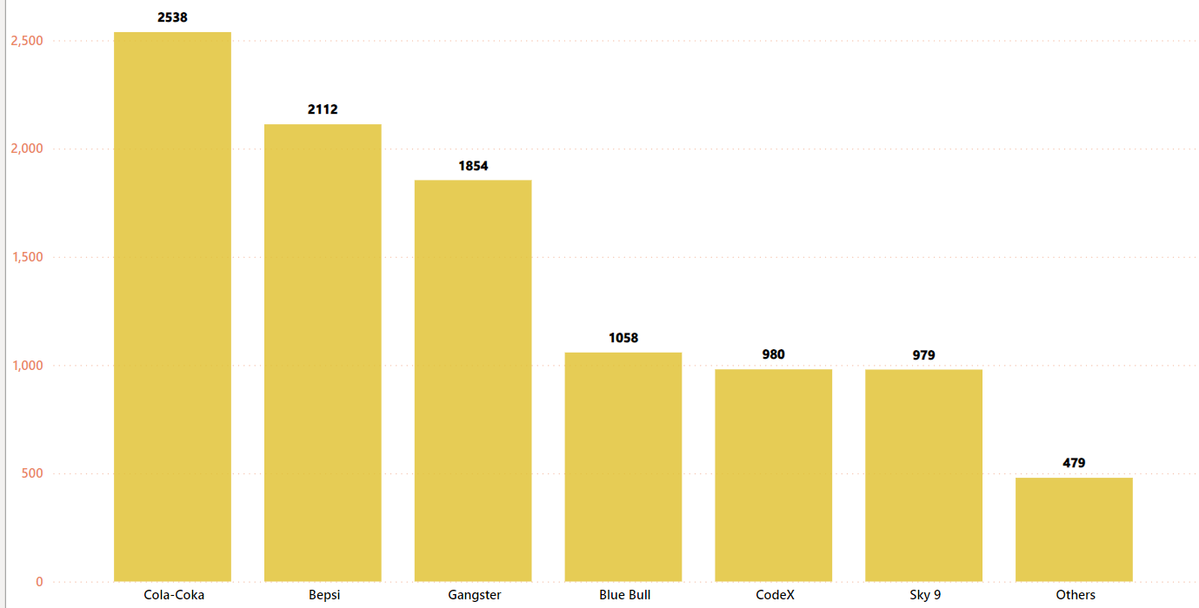
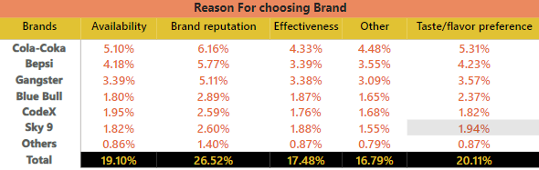
Market Leaders
Cola Coka is leading the market followed by Bepsi. The data shows there more respondents for Cola Coka than the other brands.
The top reason for choosing the brands by consumers is brand reputation.
Following that Availability is the reason for choosing the bran

Slide 9
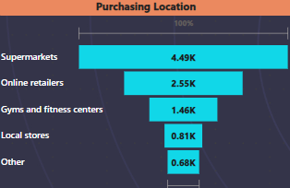
Supermarkets are the most common choice among consumers to buy energy

Slide 10
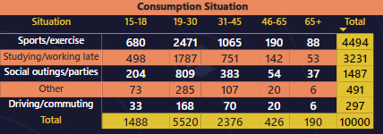
Sports/exercise & Studying/working late are the major consumption situation. Also, this data shows youth is consuming these drinks more.
Consumption Reason

Slide 11
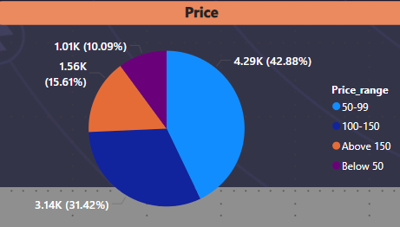
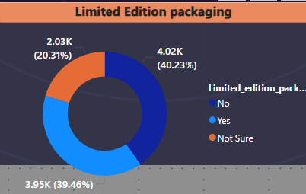
Factors Influencing Purchasing Decision
Price Analysis
43% of the consumers buy a product if the price is between 50-99.
Limited Edition Packaging
40% of the consumers do not expect a change in the packaging while 39% of consumers are open to trying the Limited Edition Packaging.

Slide 12
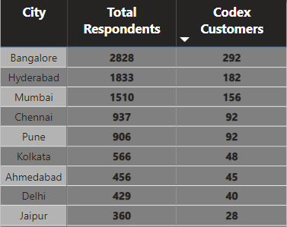
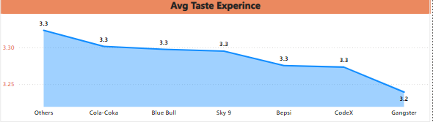
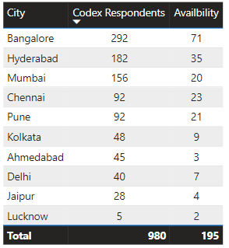
Brand Penetration
Average rating for codex drink is 3.3 which is similar to other brands
This Data shows people’s perception of CodeX as a brand in different cities.
Company need to put more focus on Jaipur , Delhi , Ahemdabad , Kolkata , Pune , company need to market the product more , make the brand awareness by organizing events .
Also We Need to focus more on the cities as product is not even easily available .

Slide 13
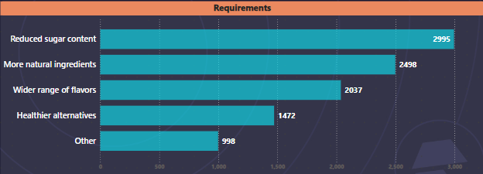
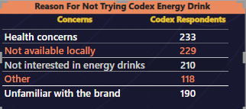
Product Development
As Data Clearly suggest people want less sugar content , more natural ingredients and more flavors .
Company need to work on brand availability, brand awareness , and also educate user about no impact on health and benefits of consuming Energy Drink

Slide 14
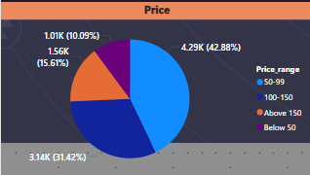
Recommendations Ideal Price ?
The price range expected by consumers lies between 50 to 150.
In cities like Ahmedabad, Chennai, Hyderabad, Kolkata, Lucknow, Mumbai, and Pune consumers expect the price range to be between 50 to 99.
While in the rest of the cities, people are willing to pay up to 150.

Slide 15
Recommendations
Offers & Discounts
we can provide offers on buying the pack of 6 cans at a cheaper cost.
Also, each of these cities celebrates multiple festivals throughout the year. We can come up with the gift set packs.
Marketing campaigns
Social Media
Influencer Marketing
Online Retailers/E-commerce
Guerilla Marketing

